Slide 1

IIIT Sri City – Emids Healthcare Hackathon

Slide 2

What are we trying to solve ?
Fast entry of eRx
Problem Statement:
To be able to enter a prescription with structured data in a software system, within a comparable time to hand written prescription.
Constraints :
Structured components of a prescription are: Medication Name with RxNORM code, dosage, route, frequency, and additional instructions.
Medication Name, dosage, and RxNORM code, will be available in an industry standard drug database, which needs to be integrated into the solution.
To – Be:
The data entry burden of prescriptions should be reduced, and be comparable to that of hand written prescription.
User can create a prescription for one drug within 30-45 seconds.

Slide 3
How are we trying to solve?
In our machine learning journey, more often than not, we have found that feature pre-processing is a more effective technique in improving our evaluation metric than any other step, like choosing a model algorithm, hyperparameter tuning, etc. We are following six stages for developing a model.
The Six stages are as follows:
Define an Machine Learning Problem and To propose a solution:
In this part of the Model, The Problem is to reduce the Entry time of the Patients and ease of maintaining the Patient's prescription details.
The Solution is to train a model which can take the Prescription from the stored Database and format it into a Hand-Written Prescription.
Here, we provide as many datasets as possible and train the model in an efficient way.
Constructing the Dataset:
In general, machine learning depends heavily on the data.
It’s the most crucial aspect that makes algorithm training possible.

Slide 4
The basic need and the best way to train a model is to have a good dataset. Before we train a model, We need a Dataset. For our Application, The Datasets we used are the Text and Numerical datasets.
Transforming the Dataset and Selecting the Required Features:
From the present Database, we have to reduce the redundancies and segregate the Data together.
The "NULL" Attributes in any column is managed accordingly and trained our model.
Choose and Train a Model
Using the Model to make Predictions:
The prediction of our Model is that, the user can enter the medication details in a prompt window and further process it into a Hand-Written type prescription with other details along with the prescribed medications. The model is very user-friendly and any user can use it with ease.
Test and Validate the model:
The model we are developing is that it can take the Input for a Prescription through a Prompt
and translate it into a hand written and Digital Prescription format.

Slide 5

Business Model Canvas
Key Activities
Medical Software development
Drug data and Patient prescription records management
Value Proposition
Streamline the entry of prescription by doctors or pharmacists
Essential data to insurance companies
Customer Relationships
Save doctor's and pharmacist's time
Enables Availability of essential data to pharmacy and insurance companies
Customer Segments
Medical Insurance
Medical Services
Hospitals
Managed Care
Pharmacies
Key Resources
Software Development Team
Staff
Industry Standard Drug Database
Channels
PC Software
Cost Structures
Software Development Cost
Revenue Streams
Doctors and clinics annual and monthly subscription package
Key Partners
Physicians
Hospitals

Slide 6

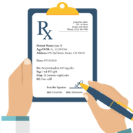
Member Roles
Team Name: Ethical Eagles
Team lead
UX / UI Designer
Developers (Frontend / Backend)
Kareemulla Ashraf Ali
Bhanu Prakash Bhaskarla
Domain Experts
Dr Chandra Mohan D
Dr Santosh Amilpur

Slide 7

Roadmap for next 2 days
Day 3
Finalize the model with a proper validation of the same
Upload a video on YouTube & Codebase
Presentation before jury members
Day 2
Enhancing BMC
Transforming the database for an efficient model
Test the model
Day 1
Inaugural
Presentation
Presentation

Slide 8
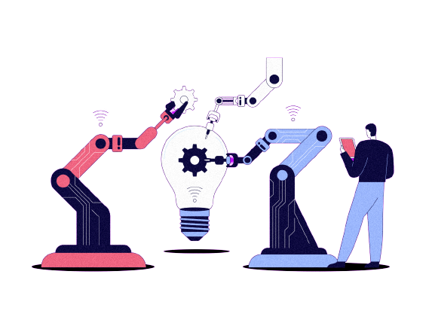
Plane of Action
Developing a software
Enhancing Business Model Canvas
Algorithm and Libraries to reduce the search and entry time
Fast entry of eRx
Deploy
Train
Transforming an industry standard drug database to obtain required data sets

Slide 9

By
Ethical Eagles
Thank You

